Slide 1
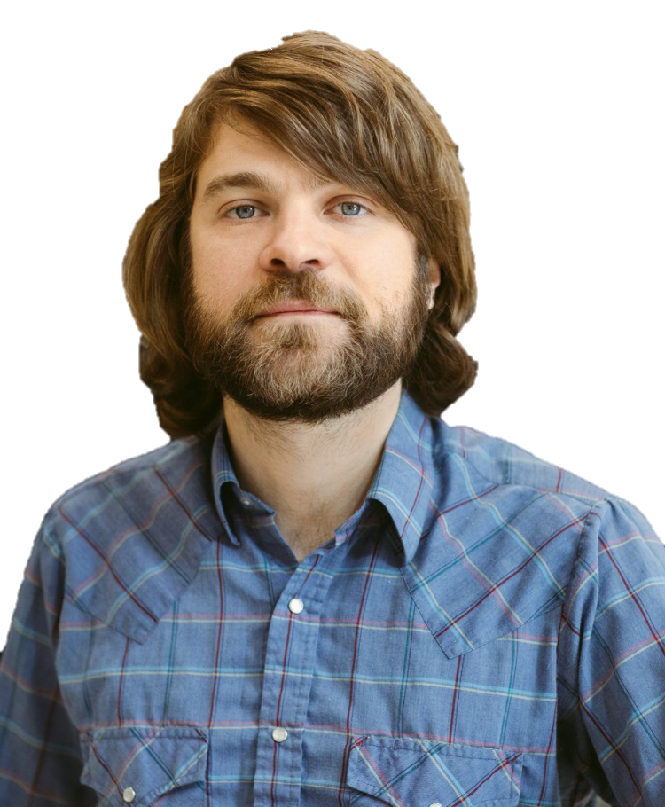

A Circular Diffusion Model of
Source Memory
Dr. Adam Osth
Prof. Philip Smith

Slide 2


Source Memory
Information about the origin of items in memory.
Notes:
Context important: encode, organize, and retrieve information
Source of a “fact”
Amnesia
Important for how much we trust partial info, also general models of episodic memory- gloss

Slide 3

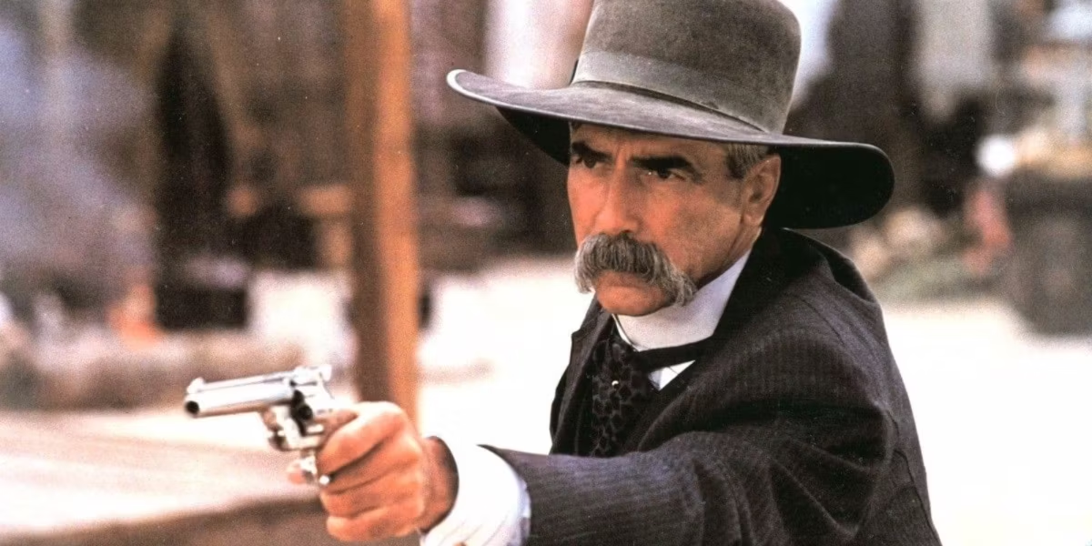


Source Memory
Information about the origin of items in memory.
Notes:
Context important: encode, organize, and retrieve information
Source of a “fact”
Amnesia
Important for how much we trust partial info, also general models of episodic memory- gloss

Slide 4
Source Memory
Information about the origin of items in memory.
Is source retrieval
Thresholded
or Continuous?
Notes:
Context important: encode, organize, and retrieve information
Source of a “fact”
Amnesia
Important for how much we trust partial info, also general models of episodic memory- gloss

Slide 5

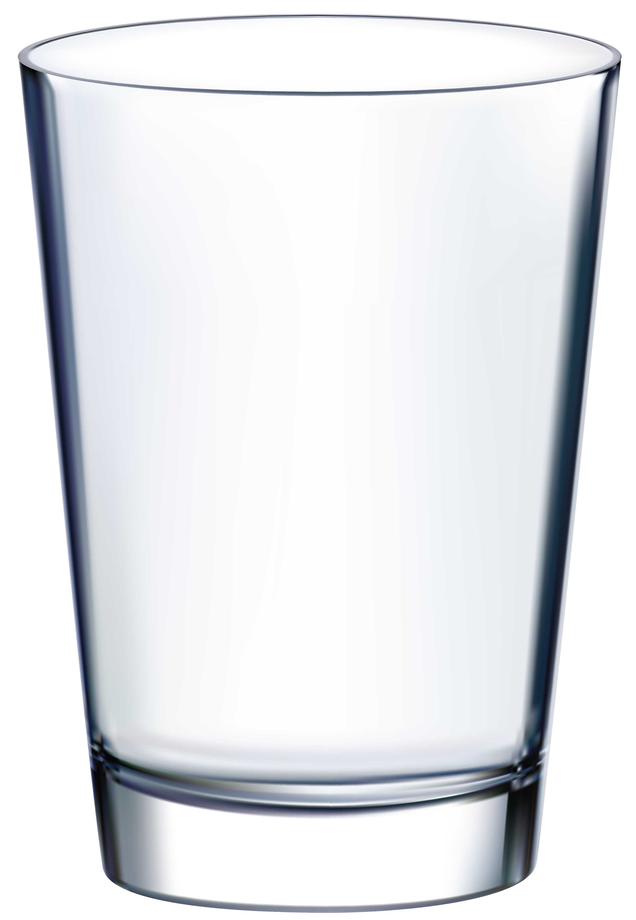

Thresholded
or Continuous?

Slide 6
Thresholded
or Continuous?

Slide 7

Thresholded
or Continuous?

Slide 8
Thresholded
or Continuous?

Slide 9
Thresholded
or Continuous?

Slide 10
Thresholded
or Continuous?

Slide 11

1. Continuous-Outcome Tasks
Responses made on a continuous (often circular) domain
Error°
WORD

Slide 12
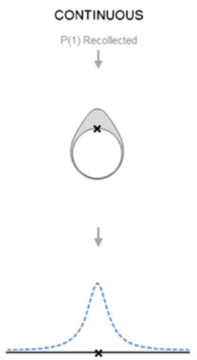
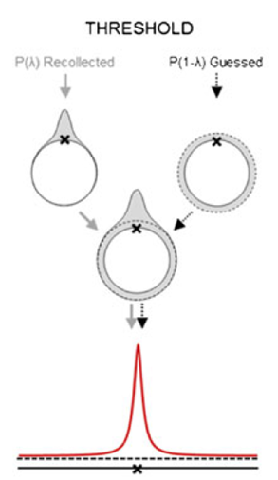
Harlow & Donaldson (2013)
Memory
Response
Harlow, I. M., & Donaldson, D. I. (2013). Source accuracy data reveal the thresholded nature of human episodic memory. Psychonomic bulletin & review, 20(2), 318-325.

Slide 13
2. Decision-Making
Memory
Response

Slide 14
2. Decision-Making
Memory
Decision
Response

Slide 15

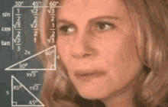


Memory
Decision
Response

Slide 16
What’s circular diffusion got to do with it?
Continuous-Outcome
Source judgements are not always binary
Two-choice data is limited
Decision-Making
Responses are not a “direct readout” of memory
Decisions occur over time

Slide 17
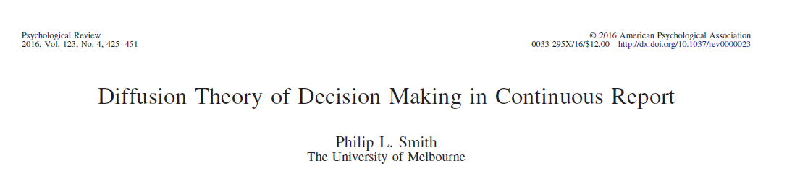
The Circular Diffusion model

Slide 18
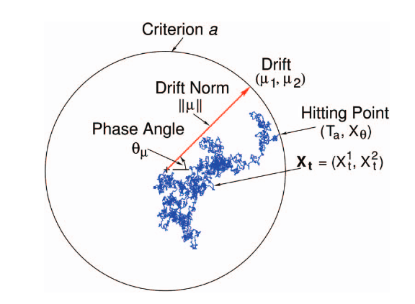
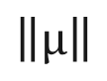

The Circular Diffusion Model
R
$$\left\|μ\right\|$$
From P. L. Smith (2016). “Diffusion theory of decision making in continuous report’ Psychological review, 123, 425-451. Figure 2. Copyright American Psychological Association.
Notes:
The drift rate is vector-valued and consists of two components, (μ_{1,} μ₂), which jointly specify its magnitude and direction. In polar coordinates the magnitude is represented by the drift norm ||μ|| and direction is represented by the phase angle θ_{μ}

Slide 19
The Circular Diffusion Model
R
Variable Drift
On Average:
Higher precision
Faster response time
Lower precision
Slower response time
High Drift
Low Drift

Slide 20
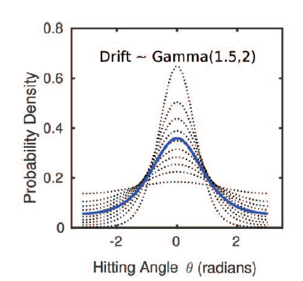
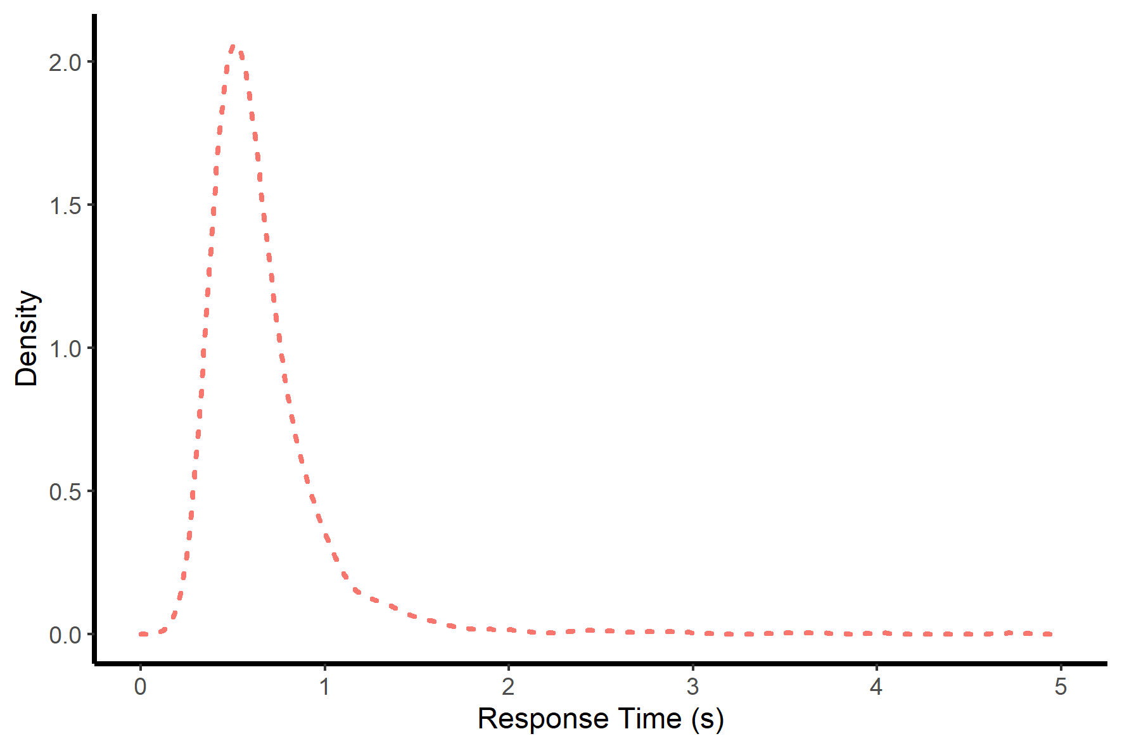
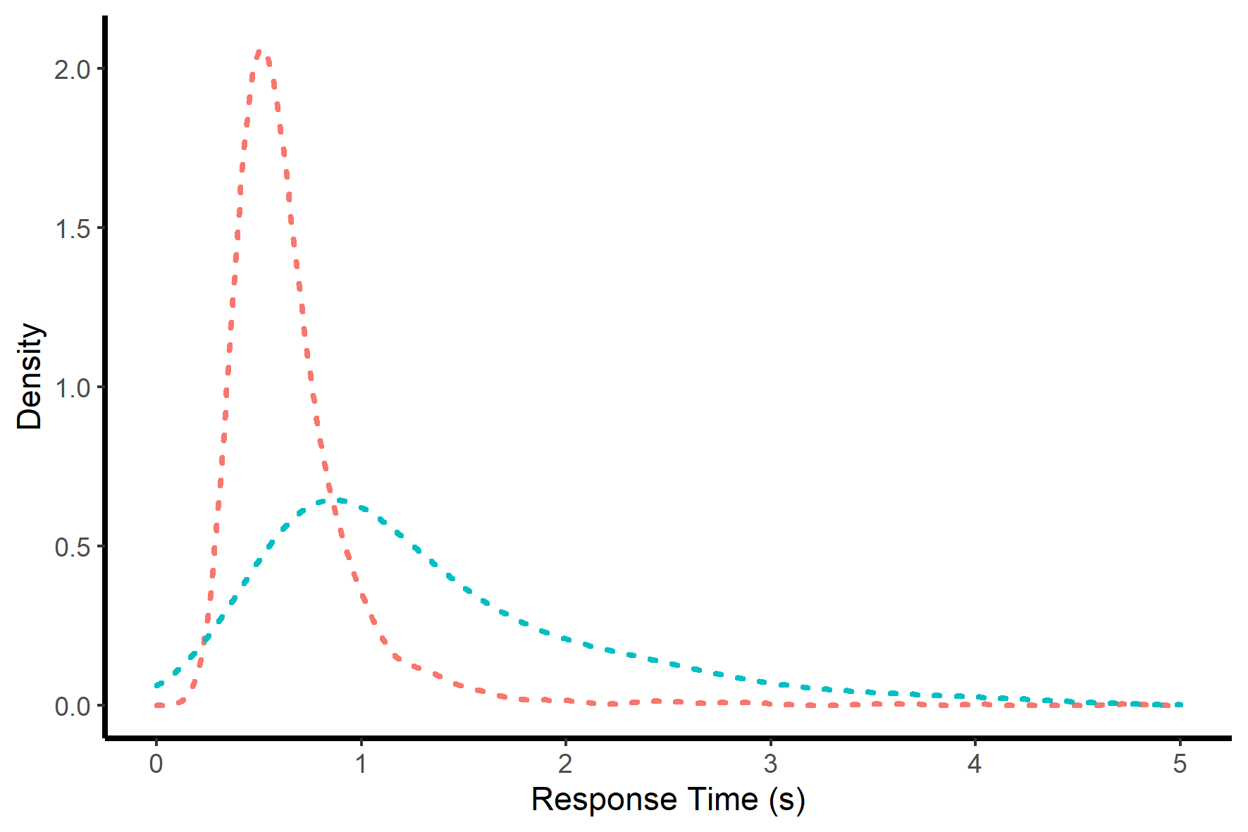
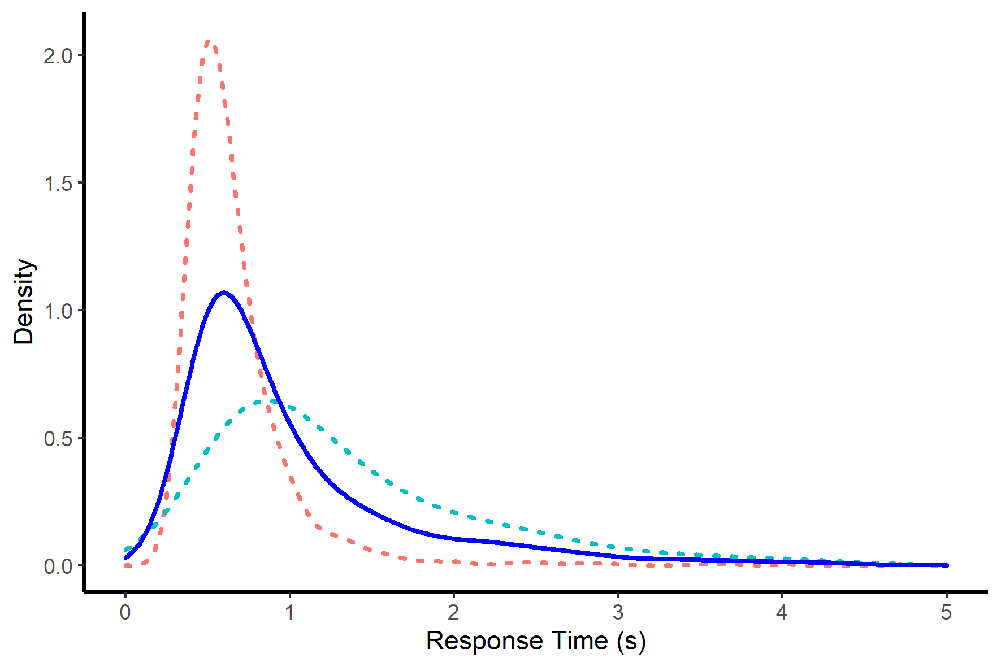
Drift Rate Variability
R
High Drift
Overall
Low Drift
-180°
0°
180°
Faster
Slower
Response Error
Response Time
Notes:
In difficult two-choice decisions in which accuracy is stressed, error RTs are typically slower than correct RTs (Luce, 1986, p. 233), especially in memoy tasks (e.g.; Osth, Bora, Dennis, & Heathcote, 2017; Ratcliff & Smith, 2004).
when drift rate varies across trials: The fastest responses are those made with the smallest error and RTs systematically increase with increasing error.

Slide 21
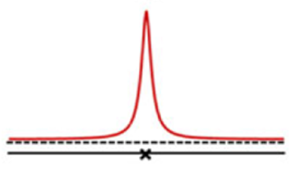
Drift Rate Variability
R
Variable Drift
Threshold
Notes:
In difficult two-choice decisions in which accuracy is stressed, error RTs are typically slower than correct RTs (Luce, 1986, p. 233), especially in memoy tasks (e.g.; Osth, Bora, Dennis, & Heathcote, 2017; Ratcliff & Smith, 2004).
when drift rate varies across trials: The fastest responses are those made with the smallest error and RTs systematically increase with increasing error.

Slide 22
Model Comparison
R
Variable Drift
Threshold
+
Zero Drift
(Guess)

Slide 23
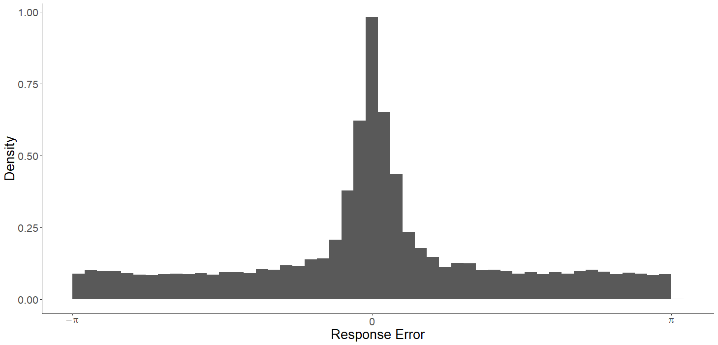

Response Error
-π
0
π

Slide 24
Response Error
-π
0
π

Slide 25
Response Error
-π
0
π

Slide 26
Response Error
-π
0
π

Slide 27
Response Error
-π
0
π

Slide 28
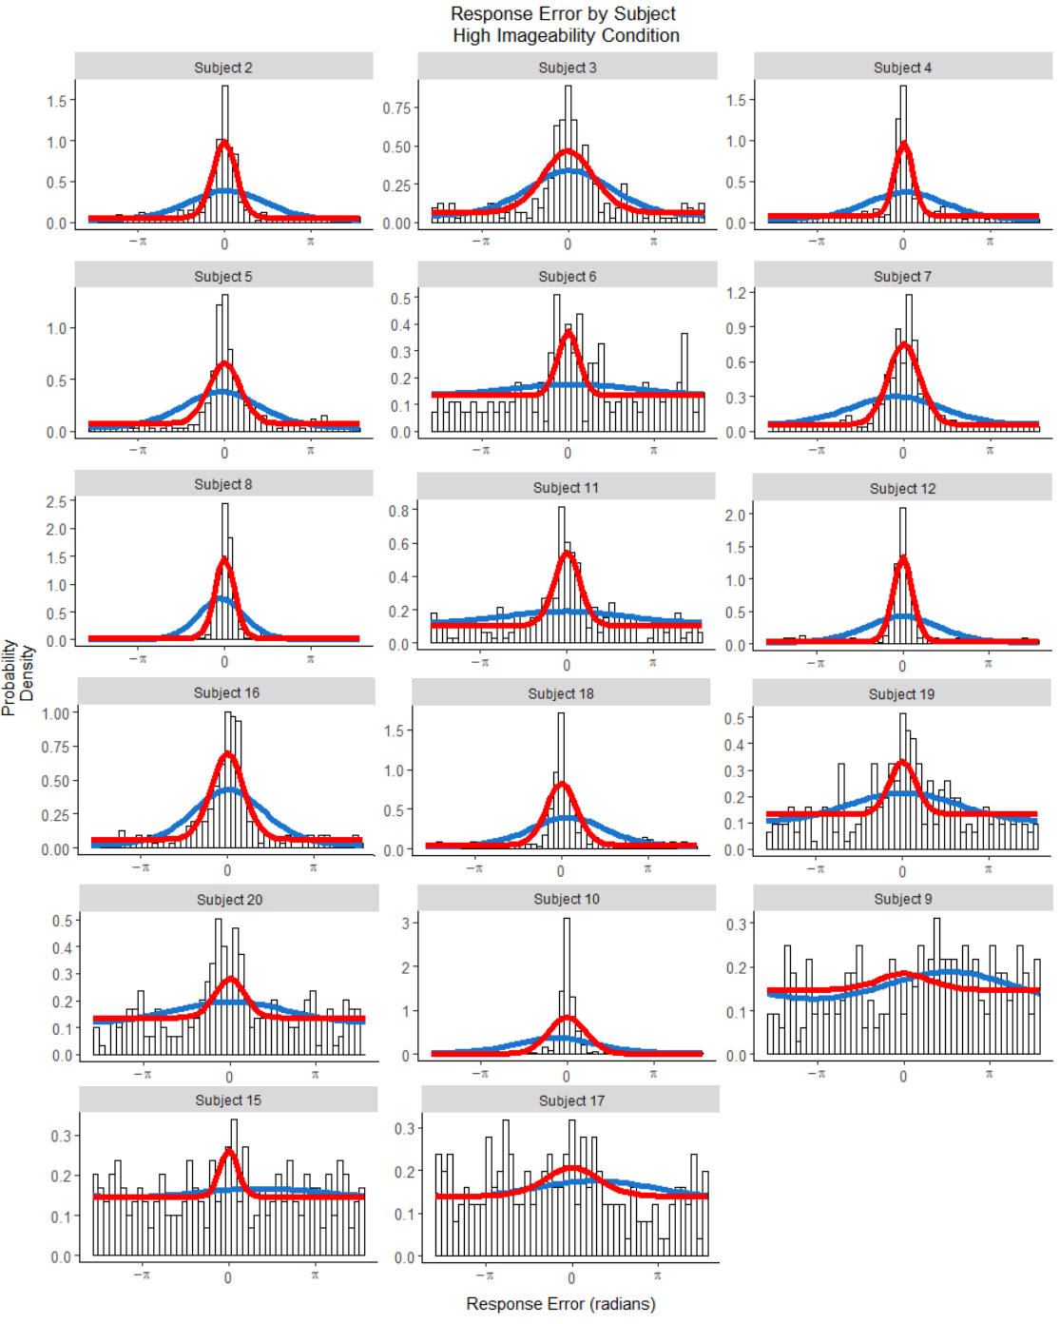
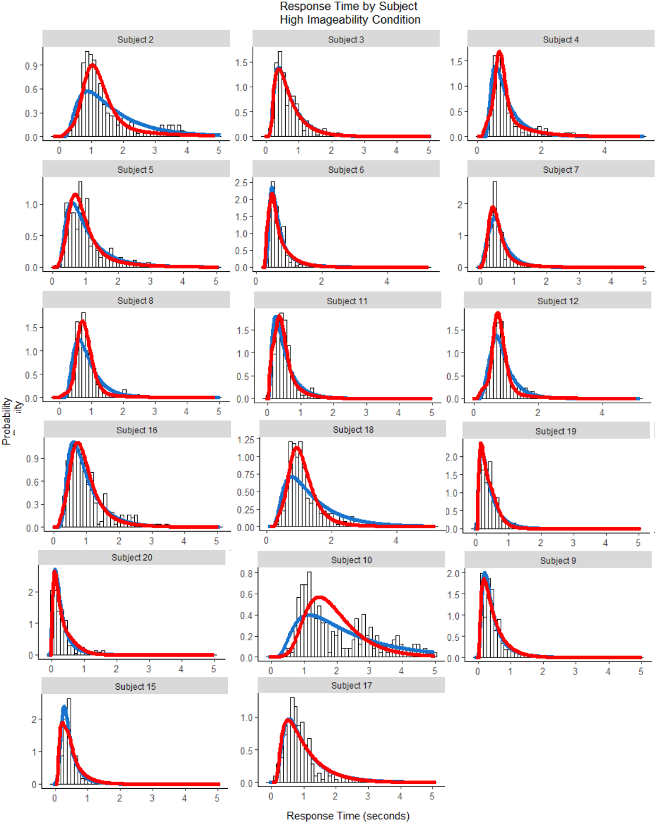
Response Error
Response Time
Density
Probability Density
Variable Drift
Threshold
Response Time (seconds)

Slide 29
Relationships between Error and RT

Slide 30
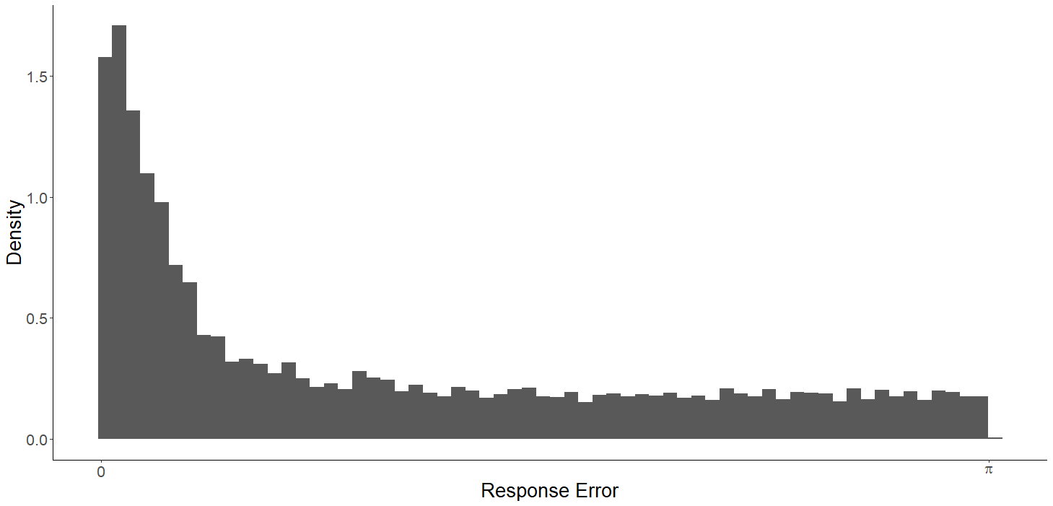
Error Percentiles
10%
30%
50%
90%

Slide 31
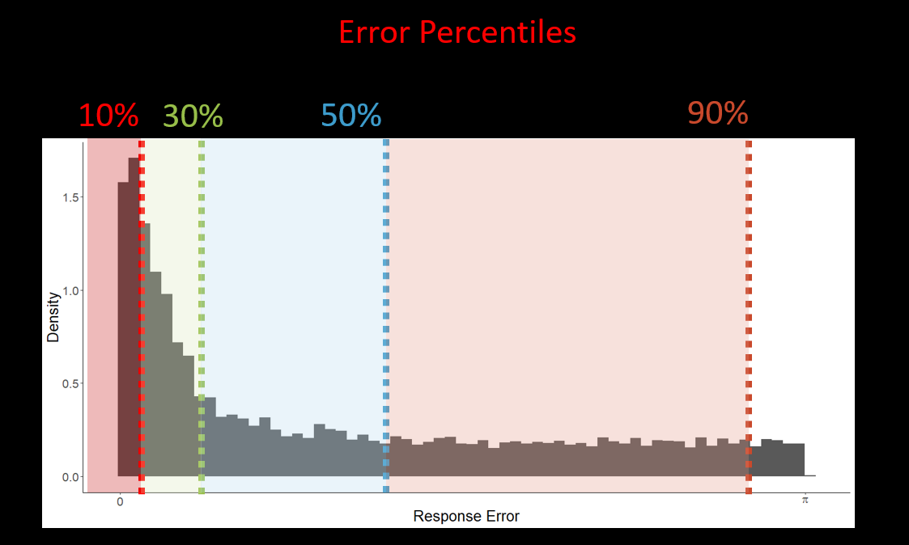
Slower
Faster
RT Percentiles
Response
Times (RT)

Slide 32
Error Percentiles
90%
10%
30%
50%
90%
50%
10%
Response Time

Slide 33
Error Percentiles
90%
50%
10%
Response Time
Notes:
when drift rate varies across trials: The fastest responses are those made with the smallest error and RTs systematically increase with increasing error.

Slide 34
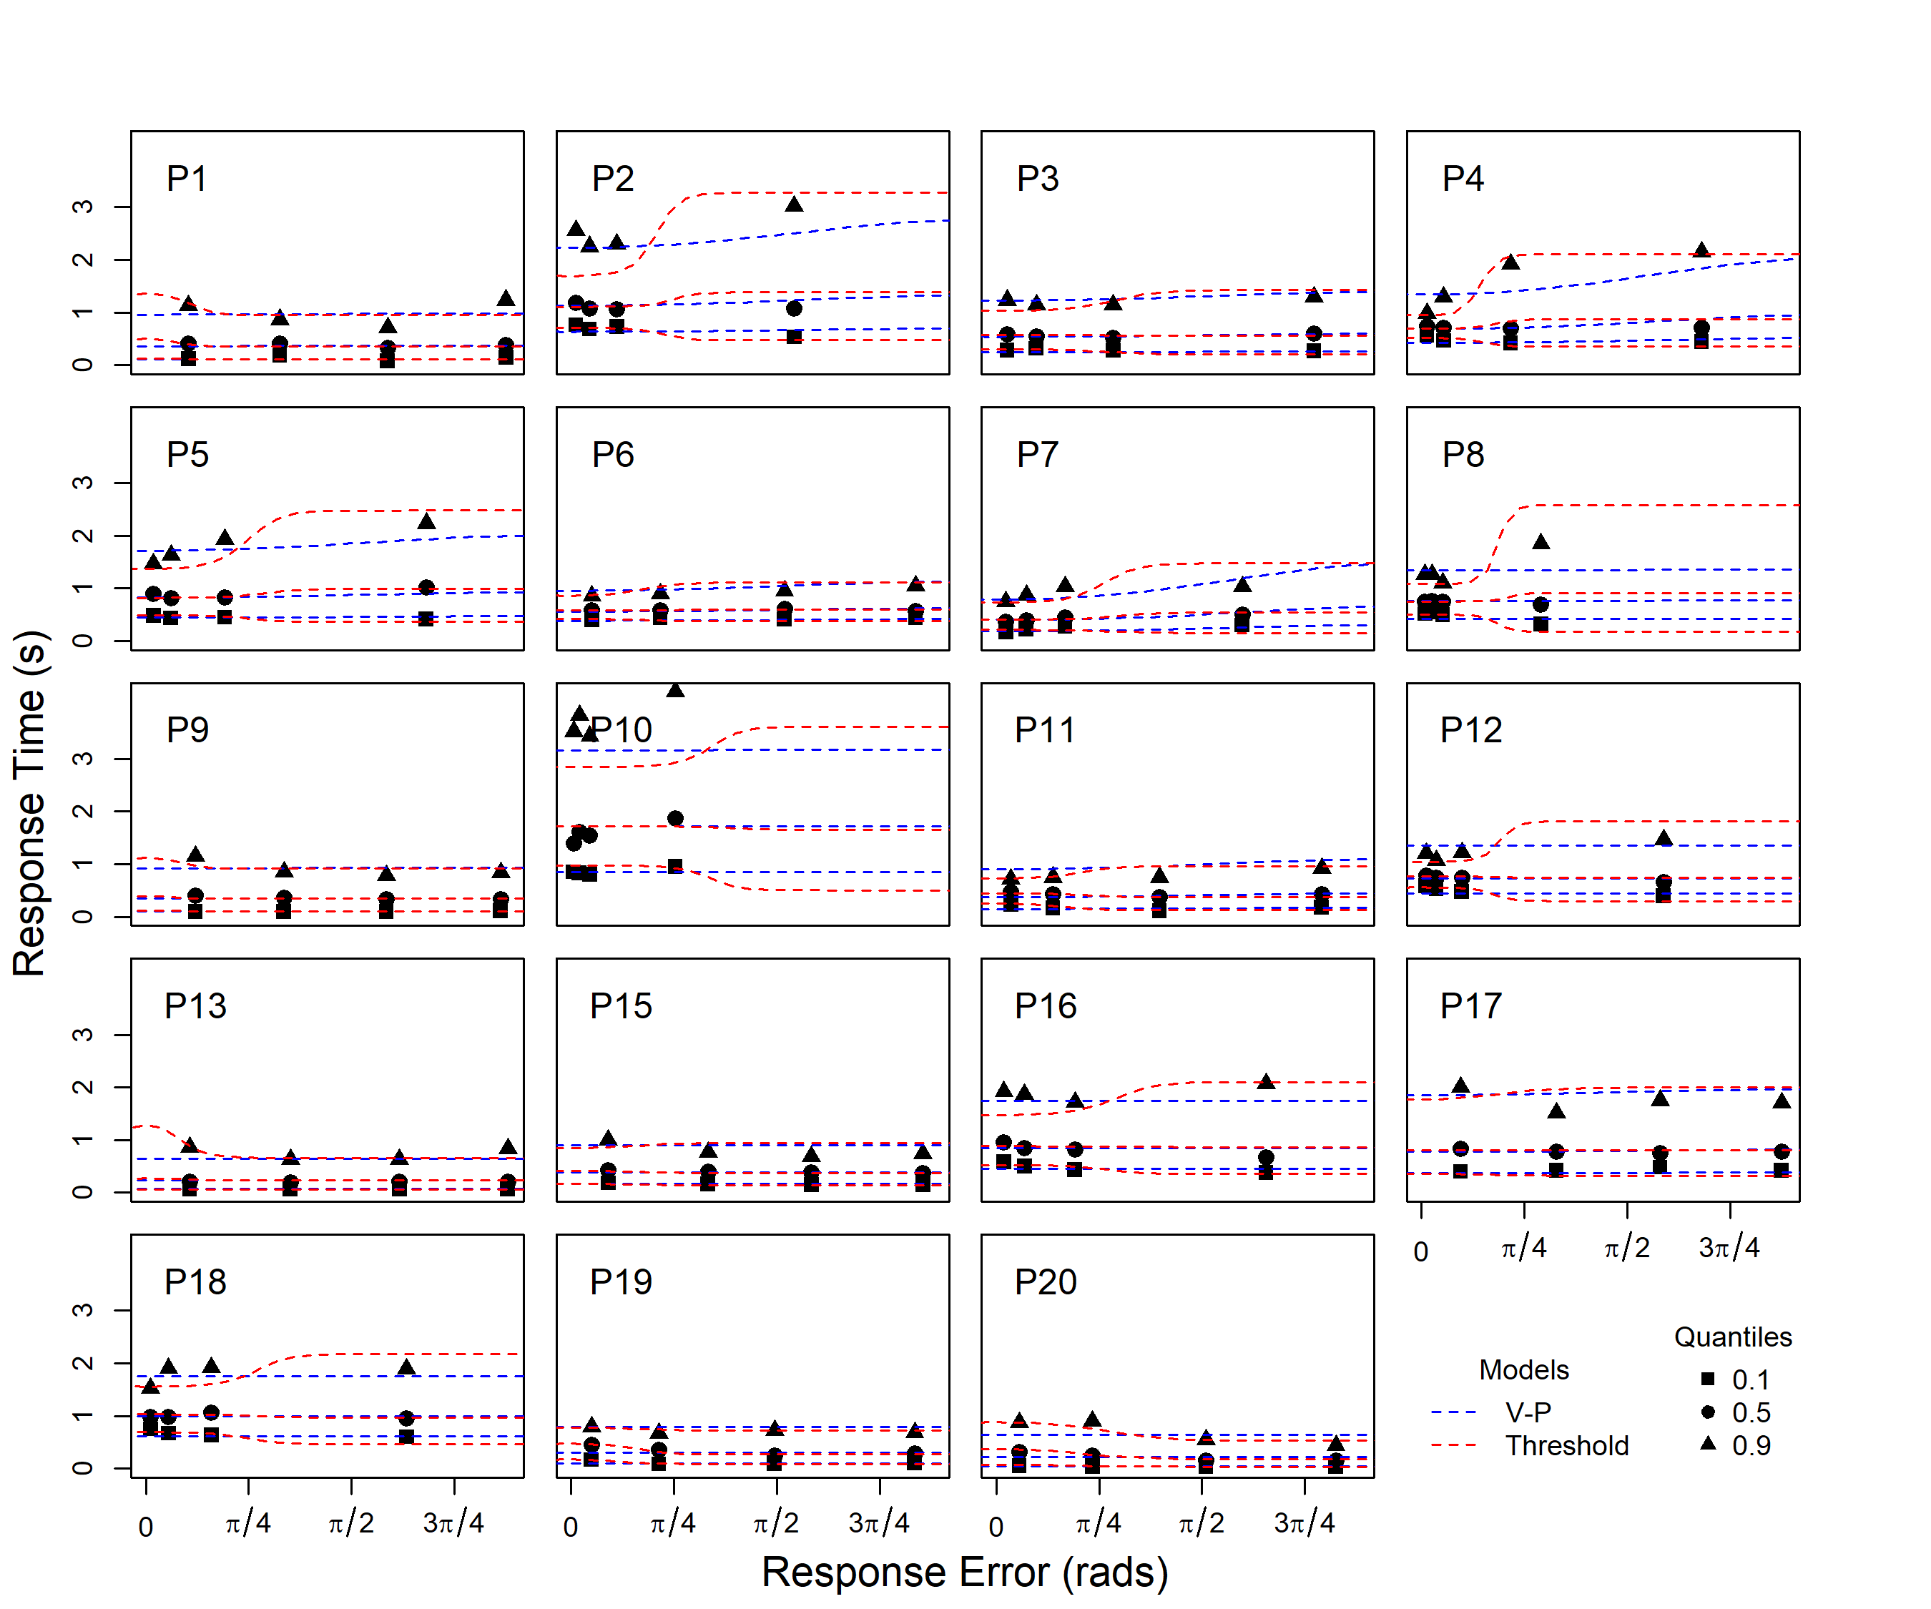
Threshold
Variable Drift
Response Time
Response Error

Slide 36
Takeaways
Heavy-tailed distribution of error is a memory, not a decision phenomenon
Source memory retrieval sometimes fails absolutely*
Joint modelling of response errors & response times
Notes:
Guesses are not due to unrecognised items
Heavy-tailed distribution is a memory phenomenon, not a decision one
Source memory retrieval appears to be thresholded

Slide 37
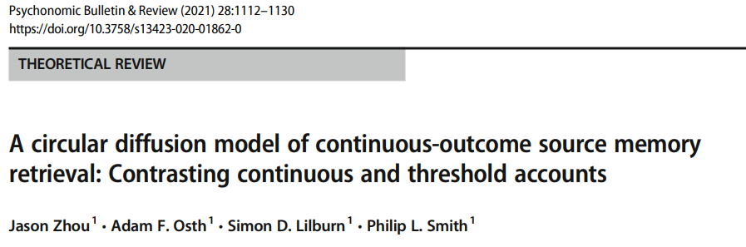

Slide 38
Response Error
Response Time
Density
Probability Density
Variable Drift
Threshold
Response Time (seconds)

Slide 39
Response Error
Response Time
Variable Drift
Threshold
Response Time (seconds)

Slide 40
Threshold
Variable Drift
Response Time
Response Error

